Slide 1
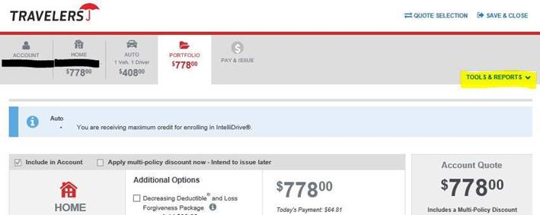


How to Flip Insurance Scores
Click on Tools & Reports in the top right corner of the quote
Click on Auto and/or Home Reports link (left side)
You’ll see the Insurance Score under Result. Scores run from 01 – 35 (with 01 being the best). Click View/Update.
Enter the spouses Name and DOB. Delete prior spouses SSN. SSN is only needed if a report is not found.
If the score improves, please make that individual the first named insured. Please note that you’ll want to go back in and flip the score for the other line of business as well.
You can update the First Named Insured on the Account/About Policy Tab
If the score is worse, please following the steps above and switch the Name and DOB back to the original spouse.

Slide 2
Rewrites
What can make a rewritten policy lower in premium? We typically see that happen in 2 instances:
Insured’s insurance score is better than when you wrote the policy with us. You can always see it in the Reports Tab.
When the insured was written with us, they had claims in the prior 5 years and now have none in the last 5 years. This will allow them to get a better rate with all other companies.
How to get an Auto rewrite:
Use the Auto Rewrite Template on our Main Screen (screenshot below). It takes under 60 seconds to complete and you’ll see the fastest turnaround.
Use this if the rewrite is eff the renewal. If at any other time, call us and ask for a rewrite indicating you are looking to save the customer with us.
How to get a Home rewrite:
If in the older programs, highlight the Home policy number and you’ll see a red ‘Rewrite button’ appear. Screenshot below. These are done in the agency at any time.
Using this feature carries over all the tenure and if the Home is under $500K, there should not be an inspection unless something significant has changed on your rewrite quote.
If the home is already in the new Quantum Home 2 program, email Piservice for the rewrite.

Slide 3
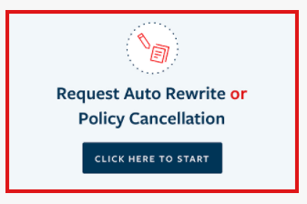
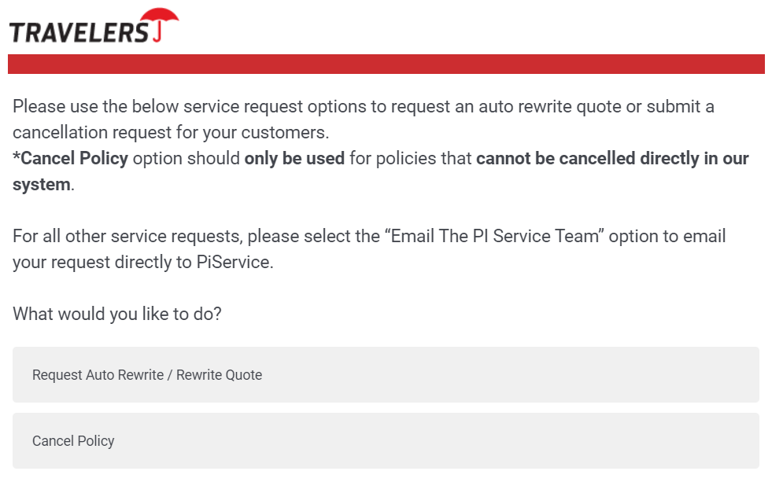
Auto Rewrites
For Agents:

Slide 4
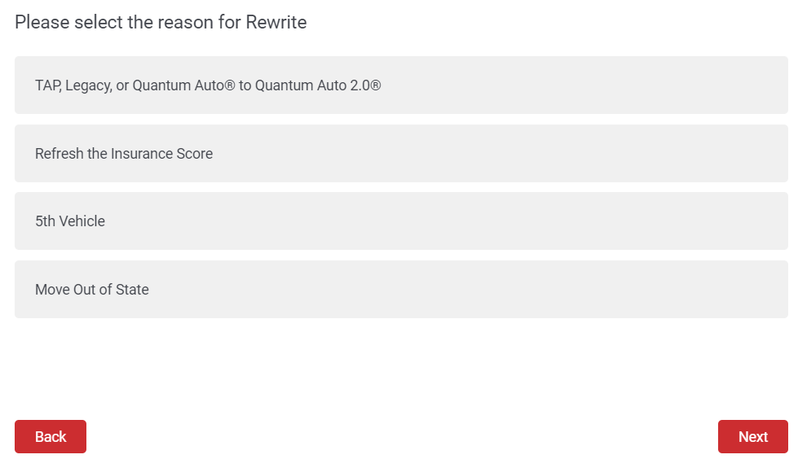
Auto Rewrites
We cannot process a quote if the renewal effective date is more than 30 days in the past or more than 90 days in the future

Slide 5
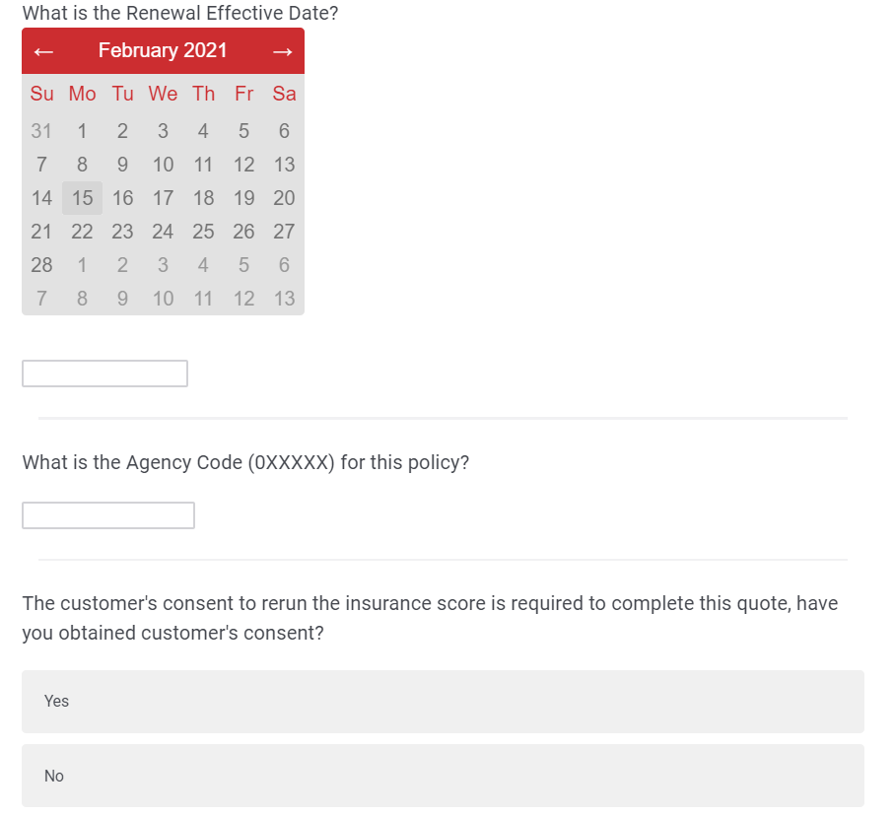
Auto Rewrites
To complete a request for a Refresh the Insurance Score Quote, the following conditions must be met:
Insurance Score Refresh has not been completed within the last 90 days
The policy renewal effective date must be within 90 days from today
The policy renewal effective date cannot be more than 30 days in the past
Refresh the Insurance Score if for the first named insured on the policy.

Slide 6
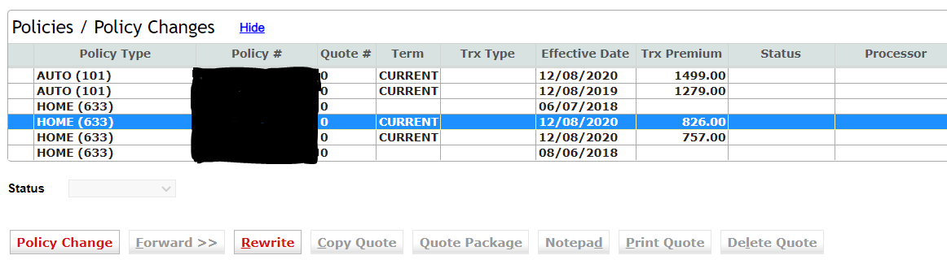
Home Rewrites

